Slide 1
Lecture 13: ANOVA and Standard Deviation
21 August 2023

Slide 2
What is Analysis of Variance (ANOVA)?
Analysis of variance (ANOVA) is an analysis tool used in statistics that splits an observed aggregate variability found inside a data set into two parts: systematic factors and random factors.
The systematic factors have a statistical influence on the given data set, while the random factors do not.
Analysts use the ANOVA test to determine the influence that independent variables have on the dependent variable in a regression study.

Slide 3
History of ANOVA
The t- and z-test methods developed in the 20th century were used for statistical analysis until 1918, when Ronald Fisher created the analysis of variance method.
ANOVA is also called the Fisher analysis of variance, and it is the extension of the t- and z-tests.
The term became well-known in 1925, after appearing in Fisher's book, "Statistical Methods for Research Workers.
It was employed in experimental psychology and later expanded to subjects that were more complex.

Slide 4
T Test
The t-test and ANOVA examine whether group means differ from one another. The t-test compares two groups, while ANOVA can do more than two groups.
The t-test ANOVA have three assumptions:
independence assumption (the elements of one sample are not related to those of the other sample),
normality assumption (samples are randomly drawn from the normally distributed populations with unknown population means; otherwise the means are no longer best measures of central tendency, thus test will not be valid), and
equal variance assumption (the population variances of the two groups are equal)

Slide 5
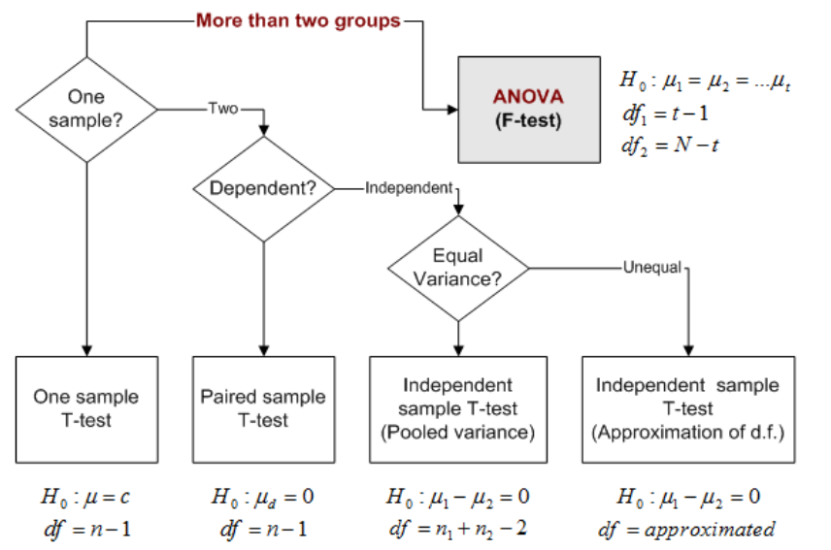

Slide 6
Key Differences Between T-test and ANOVA
The significant differences between T-test and ANOVA are discussed in detail in the following points:
T Test -A hypothesis test that is used to compare the means of two populations
Anova - A statistical technique that is used to compare the means of more than two populations is known as Analysis of Variance or ANOVA.

Slide 7
T Test
The t-test is any statistical hypothesis test in which the test statistic follows a Student’s t-distribution under the null hypothesis.
It can be used to determine if two sets of data are significantly different from each other, and is most commonly applied when the test statistic would follow a normal distribution if the value of a scaling term in the test statistic were known.
T-test uses means and standard deviations of two samples to make a comparison

Slide 8
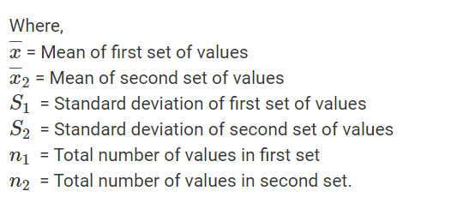
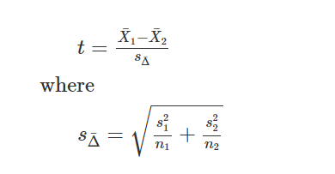
Formula T Test

Slide 9
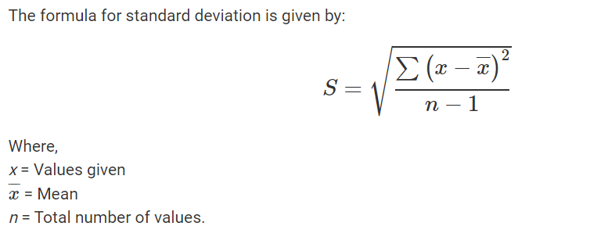
Standard Deviation

Slide 10
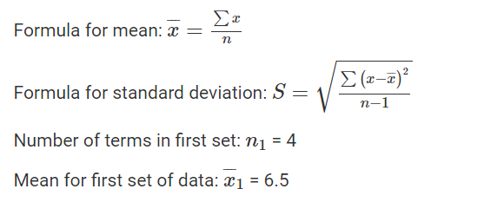
Example of T Test
Find the t-test value for the following two sets of values: 7, 2, 9, 8 and 1, 2, 3, 4?

Slide 11
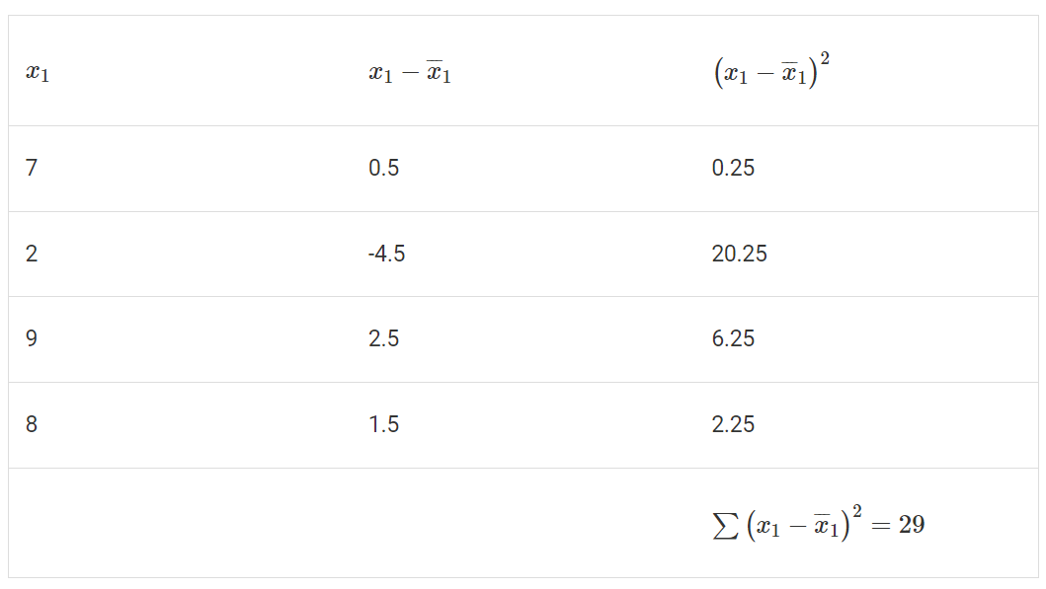
Standard Deviation

Slide 12
Standard Deviation
Standard deviation for the first set of data: S₁ = 3.11
Number of terms in second set: n₂ = 4
Mean for second set of data: x2 cap=2.5

Slide 13
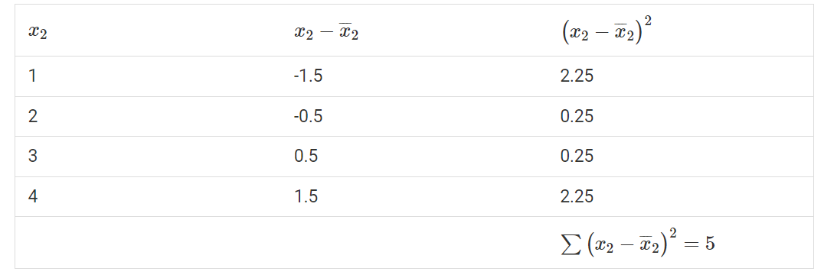
Standard deviation
Standard deviation for first set of data: S2S2 = 1.29

Slide 14
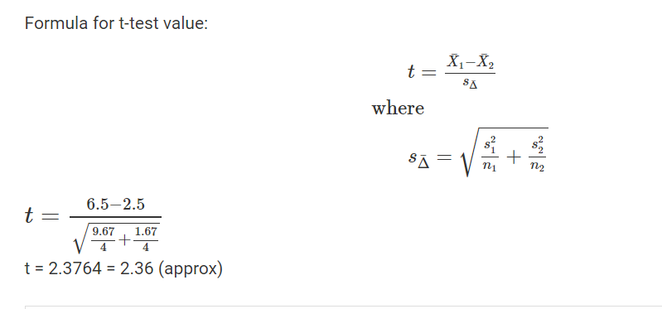
T Test Formula and solution

Slide 15
Z-Test
A z-test is a statistical test used to determine whether two population means are different when the variances are known and the sample size is large.
The test statistic is assumed to have a normal distribution, and nuisance parameters such as standard deviation should be known in order for an accurate z-test to be performed.

Slide 16
Features of Z Test
A z-test is a statistical test to determine whether two population means are different when the variances are known and the sample size is large.
A z-test is a hypothesis test in which the z-statistic follows a normal distribution.
A z-statistic, or z-score, is a number representing the result from the z-test.
Z-tests are closely related to t-tests, but t-tests are best performed when an experiment has a small sample size.
Z-tests assume the standard deviation is known, while t-tests assume it is unknown.

Slide 17
Understanding Z-Tests
The z-test is also a hypothesis test in which the z-statistic follows a normal distribution.
The z-test is best used for greater-than-30 samples because, under the central limit theorem, as the number of samples gets larger, the samples are considered to be approximately normally distributed.

Slide 18
Central Limit Theorem (CLT)
In the study of probability theory, the central limit theorem (CLT) states that the distribution of sample approximates a normal distribution (also known as a “bell curve”) as the sample size becomes larger, assuming that all samples are identical in size, and regardless of the population distribution shape.
Sample sizes equal to or greater than 30 are considered sufficient for the CLT to predict the characteristics of a population accurately.

Slide 19
Z Test
When conducting a z-test, the null and alternative hypotheses, alpha and z-score should be stated.
Next, the test statistic should be calculated, and the results and conclusion stated. A z-statistic, or z-score, is a number representing how many standard deviations above or below the mean population a score derived from a z-test is.

Slide 20
Z Score
A z-score, or z-statistic, is a number representing how many standard deviations above or below the mean population the score derived from a z-test is.
Essentially, it is a numerical measurement that describes a value's relationship to the mean of a group of values.
If a z-score is 0, it indicates that the data point's score is identical to the mean score.
A z-score of 1.0 would indicate a value that is one standard deviation from the mean.
Z-scores may be positive or negative, with a positive value indicating the score is above the mean and a negative score indicating it is below the mean.

Slide 21
Revision of Z Score
Z-scores are expressed in terms of standard deviations from their means.
Resultantly, these z-scores have a distribution with a mean of 0 and a standard deviation of 1.

Slide 22

Formula Z Score
Where,
x = Standardized random variable
x̅ = Mean
σ = Standard deviation.

Slide 23

Example 1:
How well did Ram perform in her English coursework compared to the other 50 students?

Slide 24
Computation of Z Score
Z Score = (x − x̅ )/σ
= (70 – 60)/ 15
= 10/15
= 0.6667

Slide 25
Example 2: Z score Computation
A student wrote 2 quizzes. In the first quiz, he scored 80 and in other, he scored 75. The mean and standard deviation of first quiz are70 and 15 respectively, while the mean and standard deviation of the second quiz are 54 and 12 respectively. The results follow the normal distribution. What can you conclude about the student’s result by seeing their z scores?

Slide 26
Step 1: Z score computation for Quiz 1
Calculation of student’s Z score for first quiz: Standardized random variable x = 80 Mean, x̅ = 70
Population standard deviation = 15 Formula for Z score is given below:
Z Score = (x − x̅ )/σ
= (80 – 70) /15
= 0.667

Slide 27
Step 2: Z score Computation for second Quiz
Calculation of student’s Z score for second quiz:
Standardized random variable x = 75
Mean x̅ = 54 Population standard deviation = 12
Formula for Z score is given below:
Z Score = (x − x̅ )/σ
= (75 – 54) /12
= 1.75

Slide 28
Step 3: Comparison of Scores
Since Z score of second quiz is better than that of first quiz, hence it is concluded that he did better in second quiz.

Slide 29
Example of Z Test
Examples of tests that can be conducted as z-tests include a one-sample location test, a two-sample location test, a paired difference test, and a maximum likelihood estimate.
Z-tests are closely related to t-tests, but t-tests are best performed when an experiment has a small sample size.
Also, t-tests assume the standard deviation is unknown, while z-tests assume it is known.
If the standard deviation of the population is unknown, the assumption of the sample variance equaling the population variance is made.

Slide 30
Key Features of ANOVA
Analysis of variance, or ANOVA, is a statistical method that separates observed variance data into different components to use for additional tests.
A one-way ANOVA is used for three or more groups of data, to gain information about the relationship between the dependent and independent variables.
If no true variance exists between the groups, the ANOVA's F-ratio should equal close to 1.

Slide 31
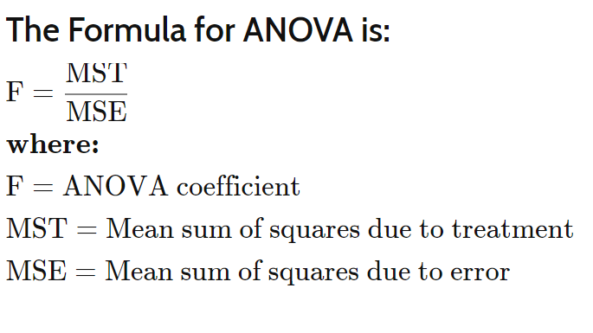

Slide 32
What Does the Analysis of Variance Reveal?
The ANOVA test is the initial step in analyzing factors that affect a given data set. Once the test is finished, an analyst performs additional testing on the methodical factors that measurably contribute to the data set's inconsistency. The analyst utilizes the ANOVA test results in an f-test to generate additional data that aligns with the proposed regression models.

Slide 33
ANOVA Test Reveals
The ANOVA test allows a comparison of more than two groups at the same time to determine whether a relationship exists between them. The result of the ANOVA formula, the F statistic (also called the F-ratio), allows for the analysis of multiple groups of data to determine the variability between samples and within samples.

Slide 34
ANOVA Reveals
If no real difference exists between the tested groups, which is called the null hypothesis, the result of the ANOVA's F-ratio statistic will be close to 1.
The distribution of all possible values of the F statistic is the F-distribution.
This is actually a group of distribution functions, with two characteristic numbers, called the numerator degrees of freedom and the denominator degrees of freedom.

Slide 35
Example of How to Use ANOVA
A researcher might, for example, test students from multiple colleges to see if students from one of the colleges consistently outperform students from the other colleges. In a business application, an R&D researcher might test two different processes of creating a product to see if one process is better than the other in terms of cost efficiency.

Slide 36
ANOVA Test
The type of ANOVA test used depends on a number of factors. It is applied when data needs to be experimental. Analysis of variance is employed if there is no access to statistical software resulting in computing ANOVA by hand. It is simple to use and best suited for small samples. With many experimental designs, the sample sizes have to be the same for the various factor level combinations.
.

Slide 37
ANOVA Test
ANOVA is helpful for testing three or more variables.
It is similar to multiple two-sample t-tests.
However, it results in fewer type I errors and is appropriate for a range of issues.
ANOVA groups differences by comparing the means of each group and includes spreading out the variance into diverse sources.
It is employed with subjects, test groups, between groups and within groups

Slide 38
One-Way ANOVA Versus Two-Way ANOVA
There are two main types of ANOVA:
one-way (or unidirectional)
and two-way.
There also variations of ANOVA. For example, MANOVA (multivariate ANOVA) differs from ANOVA as the former tests for multiple dependent variables simultaneously while the latter assesses only one dependent variable at a time.
One-way or two-way refers to the number of independent variables in your analysis of variance test.
A one-way ANOVA evaluates the impact of a sole factor on a sole response variable. It determines whether all the samples are the same.
The one-way ANOVA is used to determine whether there are any statistically significant differences between the means of three or more independent (unrelated) groups.

Slide 39
A Two-Way ANOVA
It is an extension of the one-way ANOVA. With a one-way, you have one independent variable affecting a dependent variable.
With a two-way ANOVA, there are two independents.
For example, a two-way ANOVA allows a company to compare worker productivity based on two independent variables, such as salary and skill set.
It is utilized to observe the interaction between the two factors and tests the effect of two factors at the same time.

Slide 40
ANOVA Revision
Analysis of variance, or ANOVA, is a strong statistical technique that is used to show the difference between two or more means or components through significance tests.
It also shows us a way to make multiple comparisons of several populations means.
The Anova test is performed by comparing two types of variation, the variation between the sample means, as well as the variation within each of the samples.
:

Slide 41
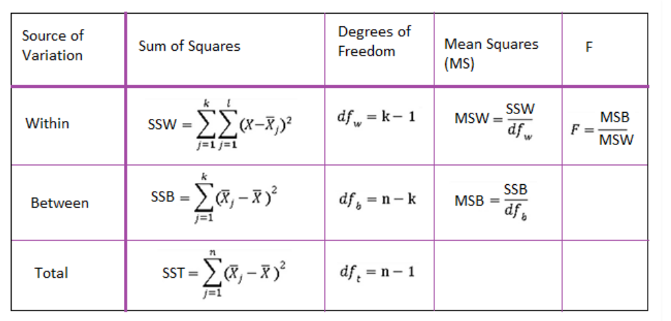
ANOVA Formula
The below mentioned formula represents one-way Anova test statistics

Slide 42
Terminologies used in Formula
F = MST/MSE
MST = SST/ p-1
MSE = SSE/N-p
SSE = ∑ (n−1)s2s2
Where,
F = Anova Coefficient
MSB = Mean sum of squares between the groups
MSW = Mean sum of squares within the groups
MSE = Mean sum of squares due to error
SST = total Sum of squares
p = Total number of populations
n = The total number of samples in a population
SSW = Sum of squares within the groups
SSB = Sum of squares between the groups
SSE = Sum of squares due to error
s = Standard deviation of the samples
N = Total number of observations

Slide 43
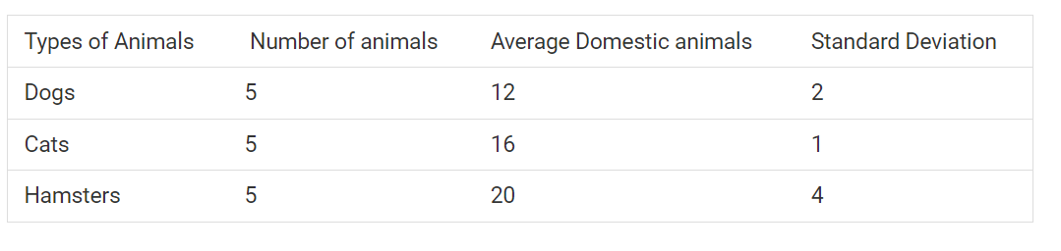
EXAMPLE
Calculate the Anova coefficient

Slide 44
Step1:
Construct the following table:
Animal name n x s s²
Dogs 5 12 2 4
Cats 5 16 1 1
Hamster 5 20 4 16

Slide 45
Step 2: Computation of SST
p = 3 n = 5 N = 15 x̄ = 16
SST = ∑n (x−x̄)²
SST= 5(12−16)²+5(16−16)²+11(20−16)² = 160

Slide 46
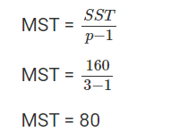
Step3:Computation of MST

Slide 47
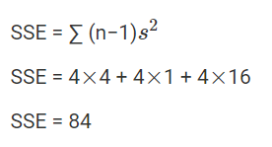
Step 4: Computation of SSE

Slide 48
Step 5: Computation of MSE
MSE = SSE/ (N-p)
=84/(15- 3)
=84/12
=7

Slide 49
Final step 6: Computation of Anova coefficient
F = MST/MSE
F=80/7
F=11.429

Slide 50
Additional Question T Test
The CEO of light bulbs manufacturing company claims that an average light bulb lasts 300 days. A researcher randomly selects 15 bulbs for testing. The sampled bulbs last an average of 290 days, with a standard deviation of 50 days. If the CEO’s claim were true, what is the probability that 15 randomly selected bulbs would have an average life of no more than 290 days?

Slide 51
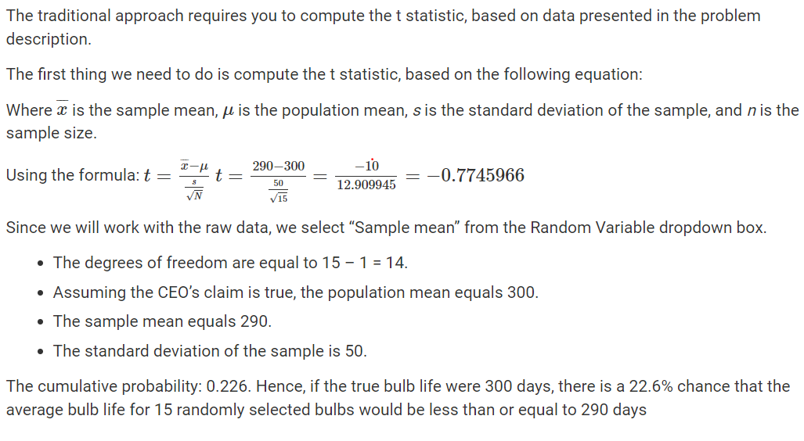

Slide 52
Thanks !!!

